Slide 1

Decision Tree Classification
Aksadur Rahman
aksadur@yahoo.com

Slide 2
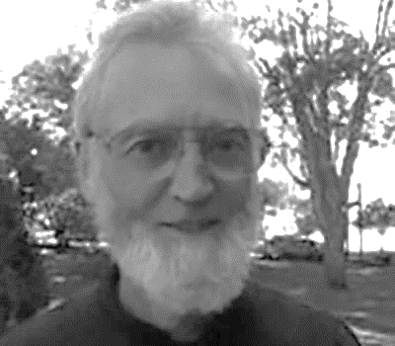
Decision Tree Classification
Ross Quinlan

Slide 3
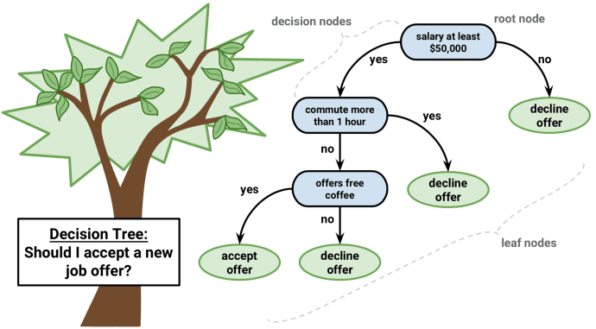
Decision Tree Classification
Decision Tree is a Supervised learning technique that can be used for both classification and Regression problems, but mostly it is preferred for solving classification problems.

Slide 4
Decision Tree Classification
Exercise:
Make a decision tree based on following training data.
Weather | Humidity | Wind | Play
Sunny | High | Weak | No
Sunny | Normal | Weak | No
Sunny | Normal | Strong | No
Cloudy | High | Weak | No
Cloudy | High | Strong | No
Cloudy | Normal | Strong | Yes
Cloudy | Normal | Weak | Yes
Rainy | High | Weak | Yes
Rainy | Normal | Strong | Yes
Rainy | Normal | Weak | Yes

Slide 5
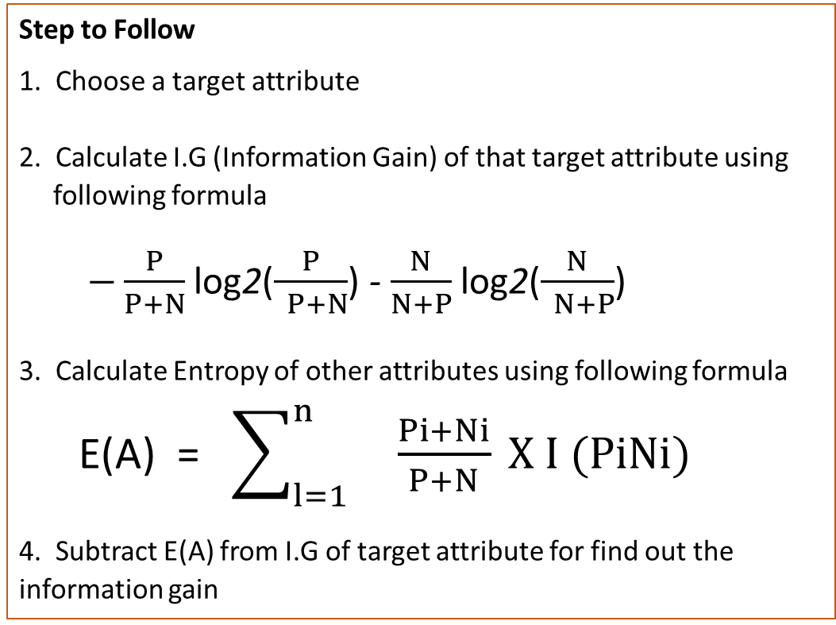
Decision Tree Classification
ID3 Algorithm: ID3 algorithm builds decision trees
Step to Follow
1. Choose a target attribute
2. Calculate I.G (Information Gain) of that target attribute using
following formula
$−\frac{P}{P+N}$ log2($\frac{P}{ P+N}$) - $\frac{N}{N+P}$ log2($\frac{N}{ N+P}$)
3. Calculate Entropy of other attributes using following formula
E(A) = $\sum_{l=1}^{n}{ \frac{Pi+Ni}{P+N}} X I (PiNi)$
4. Subtract E(A) from I.G of target attribute for find out the information gain

Slide 6
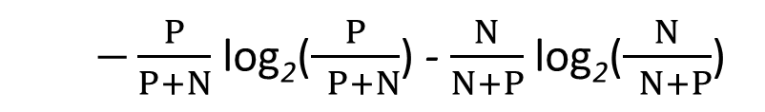
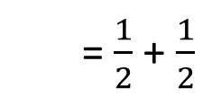
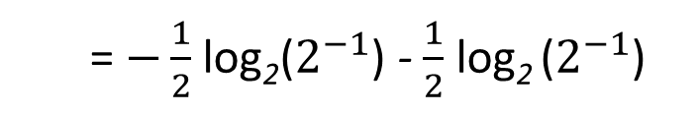
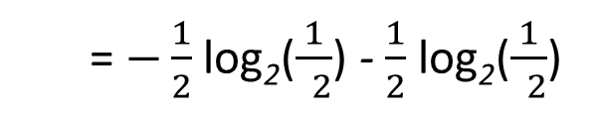
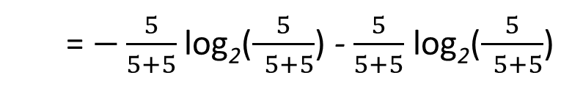
Decision Tree Classification
Information Gain for Play:
We know that,
$−\frac{P}{P+N}$ log₂($\frac{P}{ P+N}$) - $\frac{N}{N+P}$ log₂($\frac{N}{ N+P}$)
So,
= $−\frac{5}{5+5}$ log₂($\frac{5}{ 5+5}$) - $\frac{5}{5+5}$ log₂($\frac{5}{ 5+5}$)
= $−\frac{1}{2}$ log₂($\frac{1}{ 2}$) - $\frac{1}{2}$ log₂($\frac{1}{ 2}$)
= $−\frac{1}{2}$ log₂($2^{−1}$) - $\frac{1}{2}$ log₂ ($2^{−1}$)
= $\frac{1}{2}$ + $\frac{1}{2}$
= 1

Slide 7






Decision Tree Classification
Weather | No | Yes
Sunny | 3 | 0
Cloudy | 2 | 2
Rainy | 0 | 3
I.G (Sunny) = $−\frac{3}{3}$ log2($\frac{3}{ 3}$) - $\frac{0}{3}$ log2($\frac{0}{ 3}$) = 0
E(Sunny)= 0 X $\frac{3}{10}$ = 0
I.G (Cloudy) = $−\frac{2}{4}$ log2($\frac{2}{ 4}$) - $\frac{2}{4}$ log2($\frac{2}{ 4}$) = 1
E(Cloudy)= 1 X $\frac{4}{10}$ = 0.4
I.G (Rainy) = $−\frac{0}{3}$ log2($\frac{0}{ 3}$) - $\frac{3}{3}$ log2($\frac{3}{ 3}$) = 0
E(Rainy)= 0 X $\frac{3}{10}$ = 0
E (Weather)= 0 + 0.4 + 0 = 0.4
Gain (Weather)= 1 - 0.4 = 0.6

Slide 8




Decision Tree Classification
Humidity | No | Yes
High | 3 | 1
Normal | 2 | 4
I.G (High) = $−\frac{3}{4}$ log2($\frac{3}{ 4}$) - $\frac{1}{4}$ log2($\frac{1}{ 4}$) = 0.8113
E(High)= 0.8113 X $\frac{4}{10}$ = 0.325
I.G (Normal) = $−\frac{2}{6}$ log2($\frac{2}{ 6}$) - $\frac{4}{6}$ log2($\frac{4}{ 6}$) = 0.9183
E(Normal)= 0.9183 X $\frac{6}{10}$ = 0.551
E (Humidity)= 0.325 + 0.551 = 0.876
Gain (Humidity)= 1 - 0.876 = 0.124

Slide 9




Decision Tree Classification
Wind | No | Yes
Week | 3 | 3
Strong | 2 | 2
I.G (Week) = $−\frac{3}{6}$ log2($\frac{3}{ 6}$) - $\frac{3}{6}$ log2($\frac{3}{ 6}$) = 1
E(Week)= 1 X $\frac{6}{10}$ = 0.6
I.G (Strong) = $−\frac{2}{4}$ log2($\frac{2}{ 4}$) - $\frac{2}{4}$ log2($\frac{2}{ 4}$) = 1
E(Strong)= 1 X $\frac{4}{10}$ = 0.4
E (Wind)= 0.6 + 0.4 = 1
Gain (Wind)= 1 - 1 = 0

Slide 10
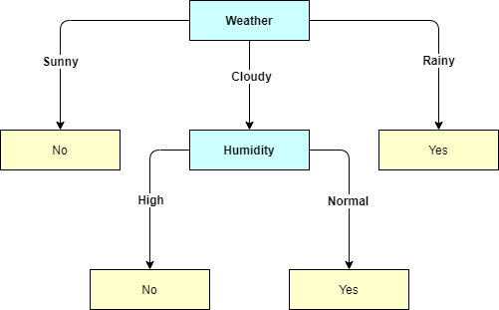
Decision Tree Classification
Here,
Gain (Weather) = 0.6
Gain (Humidity) = 0.124
Gain (Wind) = 0
Weather | Humidity | Wind | Play
Sunny | High | Week | No
Sunny | Normal | Week | No
Sunny | Normal | Strong | No
Cloudy | High | Week | No
Cloudy | High | Strong | No
Cloudy | Normal | Strong | Yes
Cloudy | Normal | Week | Yes
Rainy | High | Week | Yes
Rainy | Normal | Strong | Yes
Rainy | Normal | Week | Yes

Slide 11
Decision Tree Classification
Decision trees can be faster, however, KNN tends to be slower with large datasets because it scans the whole dataset to predict as it doesn’t generalize the data in advance.

